Slide 1
On-demand evaluation for KBP
Arun Chaganty, Ashwin Paranjape, Percy Liang, Christopher Manning
Notes:
Thank you Jason Duncan for this opportunity and to my collaborators …
I’d also like to thank Ed Hovy because this work really started after a conversation we’d had with him during the last TAC.

Slide 2
Knowledge base population is awesome.
Brings together a number of NLP tasks
Entity detection
Coreference
Entity linking
Relation extraction
Event extraction
Belief and Sentiment detection
BUT, it can be a nightmare to evaluate (and develop).
Thanks NIST + LDC!
This talk: rethinking evaluation
Notes:
Though I’ve had my advisor tell me this is a version of Stockholm syndrome, KBP is an absolutely excellent task.
One reason it is so is because it really requires us to solve a number of important (and difficult) NLP tasks.
Of course, this also makes it a pain to evaluate.

Slide 3
Knowledge base population is awesome.
Brings together a number of NLP tasks
Entity detection
Coreference
Entity linking
Relation extraction
Event extraction
Belief and Sentiment detection
BUT, it can be a nightmare to evaluate (and develop).
Thanks NIST + LDC!
This talk: rethinking evaluation
Notes:
I want to apologize that for much of this talk, I’ll be focusing on entity linking and relation extraction because that’s what I know best.

Slide 4
Outline
KBP evaluation and pooling bias
Correcting bias with on-demand evaluation
KBP Online: a publicly available evaluation service

Slide 5
Outline
KBP evaluation and pooling bias
Correcting bias with on-demand evaluation
KBP Online: a publicly available evaluation service

Slide 6





KBP evaluation through pooling
Participating systems
Evaluation dataset
New system
Icons made by Freepik and Madebyoliver from www.flaticon.com
Notes:
This is a talk about how we do evaluation and I’d like to begin there.
We’re all familiar with this story:
We submit a number of systems, and we have one “system” with people in it.

Slide 7


Pooling bias
Participating systems
New system
Pooling bias!
P: 1/2
R: 1/2
P: 2/2
R: 2/3
Icons made by Freepik and Madebyoliver from www.flaticon.com
Notes:
Need to exhibit pooling bias:

Slide 8
Does pooling have a significant effect on KBP evaluation during development?

Slide 9
Measuring pooling bias
Zobel, 1998
Participating systems
Evaluation dataset
“New” system
Icons made by Freepik and Madebyoliver from www.flaticon.com
Notes:
This is a talk about how we do evaluation and I’d like to begin there.
We’re all familiar with this story:
We submit a number of systems, and we have one “system” with people in it.

Slide 10
Measuring pooling bias: results
 | Precision | Recall | F1
Official | 17.93% | 17.00% | 15.51%
anydoc | 2.34% | 1.93% | 2.05%
Notes:
This is a talk about how we do evaluation and I’d like to begin there.
We’re all familiar with this story:
We submit a number of systems, and we have one “system” with people in it.

Slide 11
Measuring pooling bias: so what?
Pooling bias is a systematic bias
Typical system improvements: usually 1-2% F1 < pooling bias.
New system improvements are hard to identify.
The more novel the system, the larger the bias!
Empirically tuned systems (machine learning) overfit to predict only what’s already been seen.
Notes:
- Figure with

Slide 12
What can we do for teams during system development?
Also, what do we do when the NIST evaluation goes away?

Slide 13
Exhaustive annotation?
A sufficiently large corpus ~= 90,000 documents
Even with crowdsourcing: $15 / document
Total cost: $1,350,000
Maybe not?

Slide 14
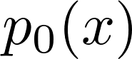
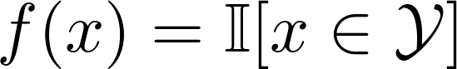
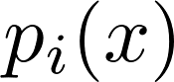
On-demand evaluation
Participating systems
Evaluation dataset
Can we make on-demand evaluation cost-effective?
New system
Icons made by Freepik and Madebyoliver from www.flaticon.com
Notes:
No difference between the new system and the original systems.

Slide 15

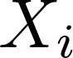
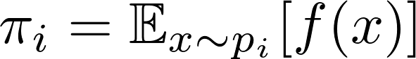
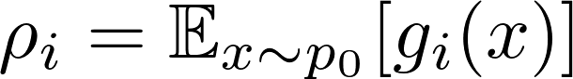
(Simple) Statistical estimators for KBP
Precision
Recall
Can we be more sample efficient?

Slide 16
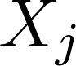
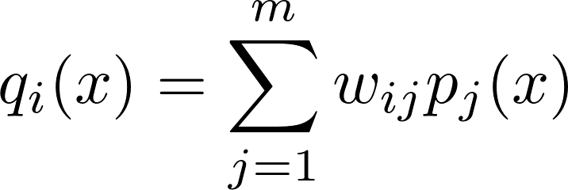
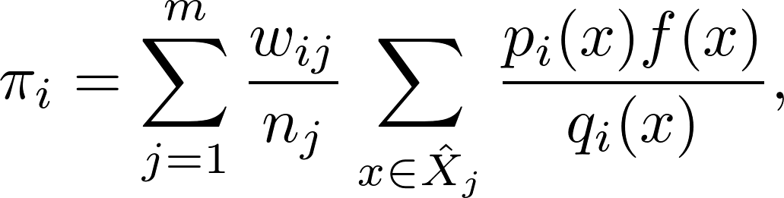
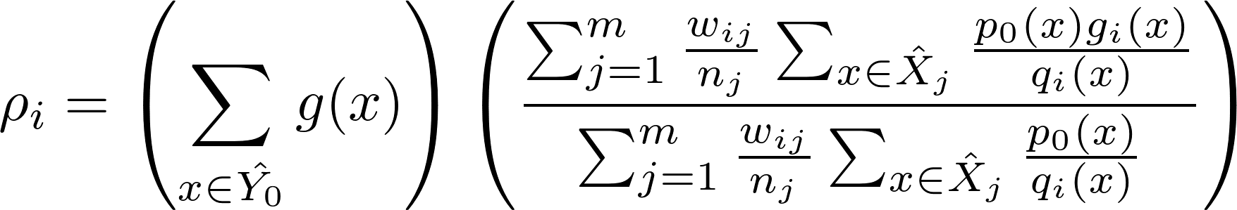
(Joint) Statistical estimators for KBP
We can fix selection bias with importance reweighting!
Recall of the pool
Recall within the pool
Precision
Recall

Slide 17
On-demand evaluation evaluation

Slide 18
Outline
KBP evaluation and pooling bias
Correcting bias with on-demand evaluation
KBP Online: a publicly available evaluation service
Notes:
Have a theoretically sound framework to evaluate KBP scalably.
But can we actually get it to work in practice?

Slide 19
Implementing on-demand evaluation
What is the distribution over system predictions: ?
How do we label instances: ?
How do we sample from set of unknown true instances ?

Slide 20
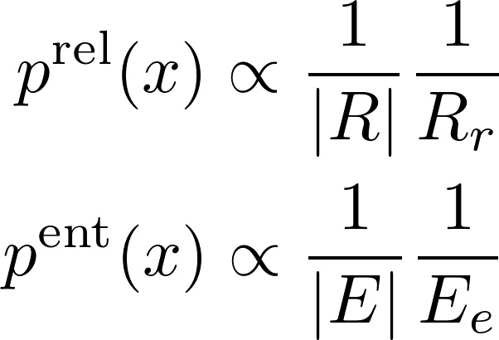
1. Distributions over system predictions
Serves as a replacement for manual queries
Allows us to tailor evaluation to balance relations or rare/common entities.

Slide 21
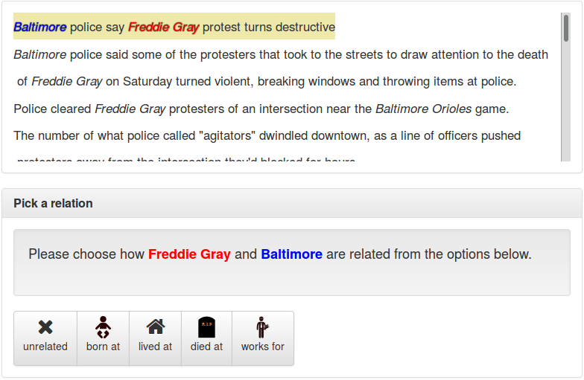
2. Labeling instances

Slide 22
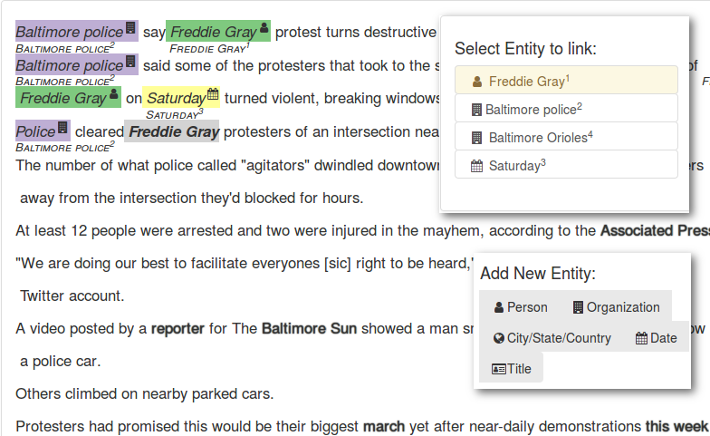
3. Sampling true instances

Slide 23
Demo
Please cross your fingers

Slide 24
Caveats and footnotes
Limited to most common relations (no “per:cause_of_death”, …)
No cross-document NIL entity linking (yet)
Restricted to newswire (discussion forum posts are nasty)
Currently in beta (Things might break)
Allow separation of entity linkers and relation extractors.
We’ll have faster turnaround times soon (fixing bugs).

Slide 25
Conclusion
Problem: current pooling methodology is biased against development systems.
Insight 1: use crowdsourcing to annotate system predictions on-demand.
Insight 2: correct for pooling bias using importance reweighting estimators.
Result: Public evaluation service at kbpo.stanford.edu!
Future:
Multilingual
Cross-document entity linking
Events? Sentiment?
?

Slide 26
Fin

